Slide 1
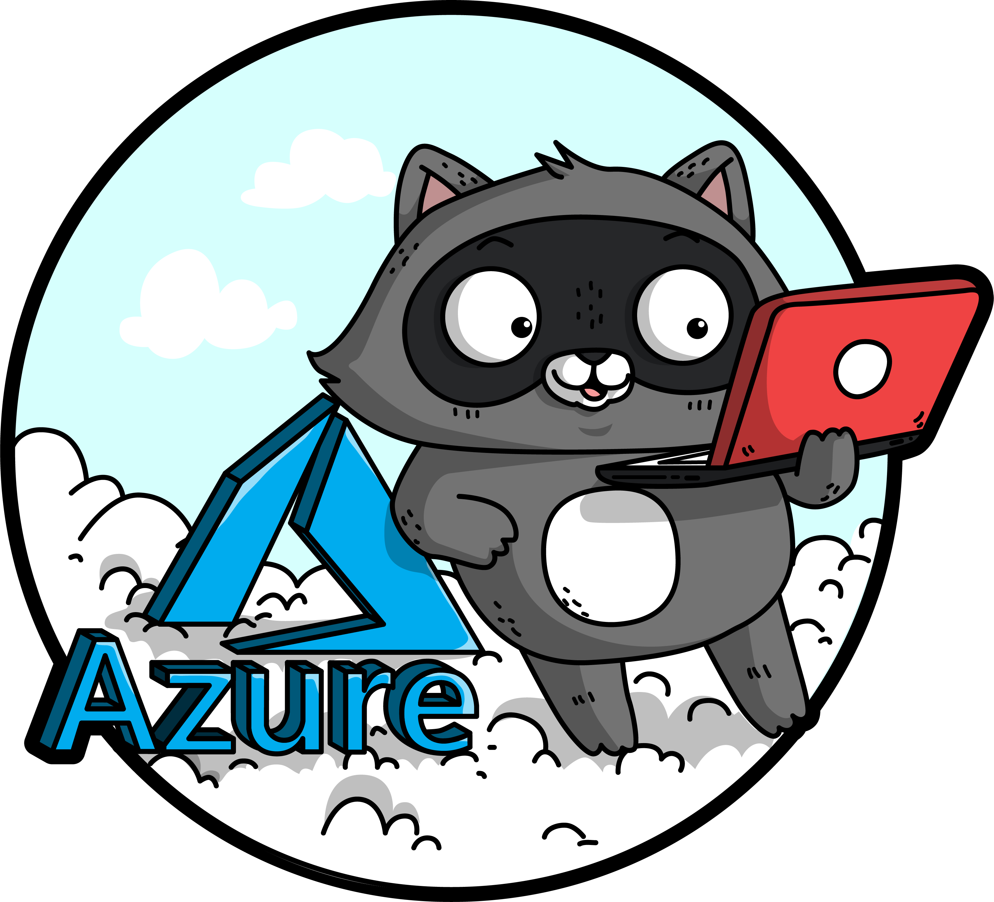
Cloud Migration Strategies
Sarah Lean

Slide 2

Sarah Lean
Cloud Solution Architect
Blogger | Curler | Photographer | Book Lover | Runner | Speaker | STEM Ambassador
13+ years experience in IT
@TechieLass
https://www.techielass.com

Slide 3
Software and hardware refresh
Security threats
Urgent capacity needs
Compliance
Quickly integrate acquisitions
Application innovation
Migration drivers
Software end of support
Datacenter contracts expiry

Slide 4
Deadline to act before end of support
Impact of end of support
No security updates
SQL Server 2008 and 2008 R2
Extended Support
ends July 9, 2019
Compliance concerns
Windows Server 2008 and 2008 R2
Extended Support
ends January 14, 2020
Missed innovation opportunities
2018
2019
2020
Find lifecycle support deadlines at: support.microsoft.com/lifecycle

Slide 5
Extended security updates for 2008 and 2008 R2 – free in Azure
IaaS: Move to Azure VMs, get 3 more years of extended security updates at no additional charge
PaaS: Move SQL Server to Azure SQL Database Managed Instance (version free, fully managed, no patching needed)
Use Azure Hybrid Benefit to maximize on-premises investments
Migrate to Azure
SQL Server 2008 and 2008 R2
Extended support
ends July 9, 2019
Windows Server 2008 and 2008 R2
Extended support
ends January 14, 2020
Upgrade to current Windows Server/ SQL Server versions
OR
Buy 3 more years of extended security updates on 2008/2008 R2
2018
2019
2020
Stay on-premises

Slide 6
Unified and extensible Azure migration experience
Assess
Migrate
Optimize
Secure and manage
Migration tools | Azure migration center | Scenario guidance | FastTrack for Azure | Azure Expert MSPs
Foundational best practices: People | Process & Planning | Technology
Notes:
Summary:
Key phases of the Azure migration experience – workload assessment and discovery, workload migration, ongoing optimization (Cost Management, AHB, RI) and security/management (built in services – backup, monitoring, blueprints etc.)
Key investments – tools, prescriptive guidance, and handholding
3) Foundational best practices which are critical enablers to help you scale up your efforts – skilling up people, investing in the right processes – e.g., biz case/exec support, mix of migration strategies, tracking migration), and tech (governance, networking, identity, security and management tools)

Slide 7








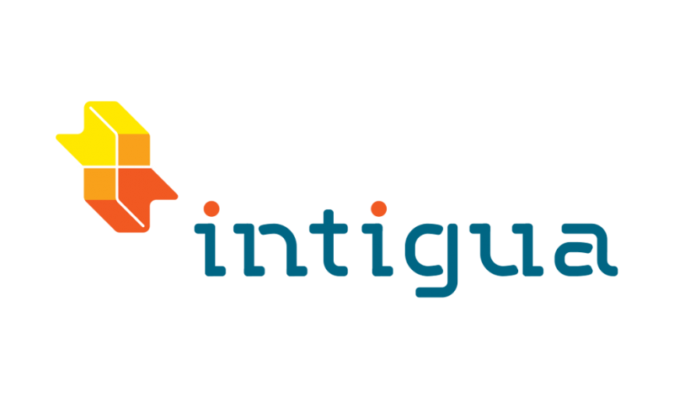
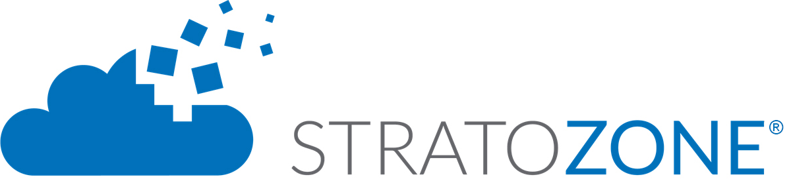







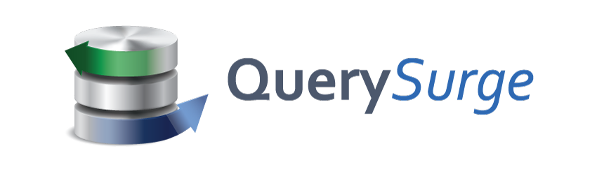
Choice of tools for every stage and every requirement
Goal is successful Azure migration: Pick the right tool for the job
Assess
Migrate
Optimize
Secure & Manage
Azure Migrate
Azure Site Recovery (ASR)
Azure Cost Management
Azure Security & Management
(e.g., Blueprint, Security Center, Backup, Monitor)
Data Migration Assistant (DMA)
Azure Database Migration Service
SQL Server Migration Assistant (SSMA)
Azure Data Box
We embrace ISV solutions

Slide 8
Cloud migration strategies
Rehost
Refactor
Rearchitect
Rebuild
Description
Redeploy as-is to cloud
Minimally alter to take better advantage of cloud
Materially alter/decompose application to services
New code written with cloud native approach
Drivers
Faster, shorter, updates
Code portability
Greater cloud efficiency (resources, speed, cost)
App scale and agility
Easier adoption of new cloud capabilities
Mix technology stacks
Accelerate innovation
Build apps faster
Reduce operational cost
Reduce Capex
Free up datacenter space
Quick cloud ROI
Technologies
IaaS
Containers
PaaS
PaaS
Serverless
Microservices
Notes:
Gartner: Developing a Public Cloud IaaS Adoption and Migration Framework, published March 2017.

Slide 9
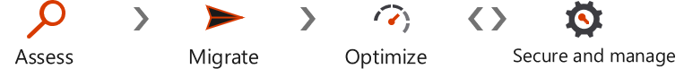
Rehost Windows Server on Azure
Migrate
Azure integration
with Windows Admin Center
Rich development experience for existing and new applications
Most cost-effective with Azure Hybrid Benefit + Azure RI + Extended security updates
Comprehensive support from a single source
* Sample annual cost comparison of two D2V3 Windows Server VMs. Savings based two D2V3 VMs in US West 2 Region running 744 hours/month for 12 months; Base compute rate at SUSE Linux Enterprise rate for US West 2. Azure pricing as of 04/24/2018. AWS pricing as of 04/24.2018. Price subject to change.

Slide 10
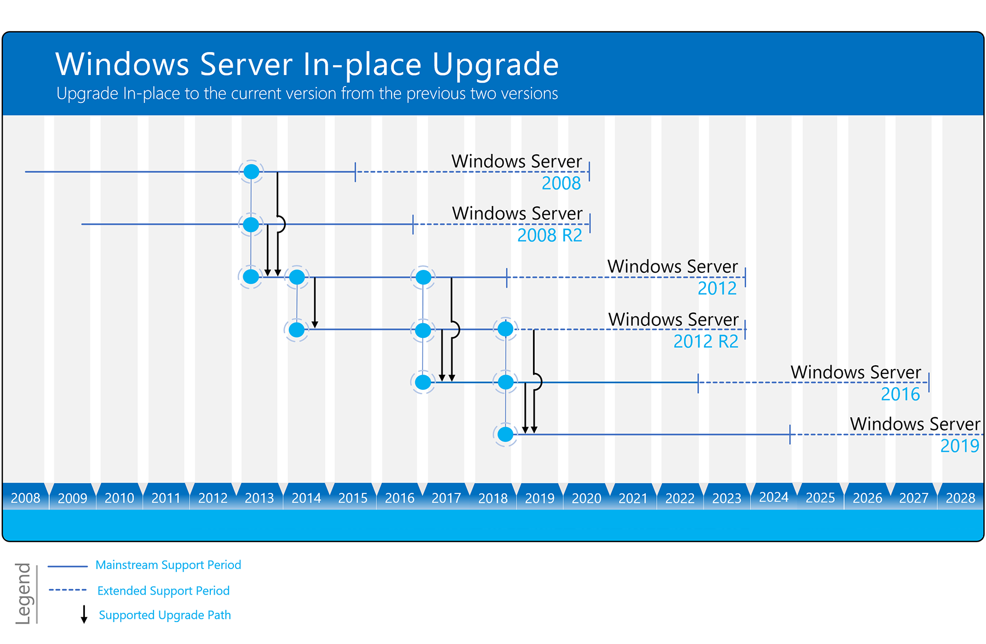
https://www.microsoft.com/upgradecenter

Slide 11
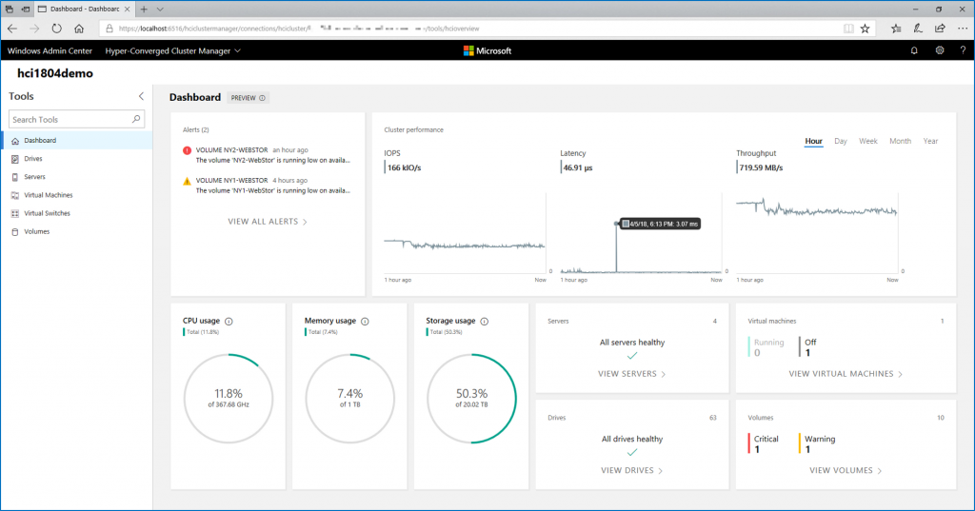
Windows Admin Center
https://aka.ms/WindowsAdminCenter

Slide 12
Saving opportunity for modernizing your data estate is significant
Platform
(as a Service)
On-premises
Infrastructure
(as a Service)
Intelligent performance/security
Applications
Applications
Applications
Data
Data
Data
High availability /DR/Backups
High availability /DR/Backups
High Availability/ DR/Backups
On-premise costs tends to be driven by hardware and data center management costs
Infrastructure-as-a-Service reduces cost categories related to data center and compute
Platform-as-a-Service off-loads customers’ most administrative tasks to Azure, further improving efficiency with machine-learning capabilities for performance and security
Managed Instance: instance-level deployment for lift-shift existing apps to Azure, fully backward compatible
Single database: database-level deployment for new apps
Database Provision/ Patch/Scaling
Database Provision/ Patch/Scaling
Database Provision/ Patch/Scaling
O/S provision /patching
O/S
O/S
Virtualization
Virtualization
Virtualization
Hardware
Hardware
Hardware
Datacenter Management
Datacenter Management
Datacenter Management
SQL Server 2017
Azure SQL VMs
Azure SQL Database
(Managed Instance, Single DB)
Managed by customer
Managed by Microsoft
Machine-learning capability

Slide 13
Azure SQL Database Managed Instance: Best for modernization at scale with low cost and effort
 | Azure SQL Database Managed Instance PaaS | SQL Server and Windows Server on Azure VMs IaaS
BEST FOR | Enterprises looking for a fully-managed database service at the instance level and/or database level | Enterprises starting cloud modernization who want to maintain OS and instance control
SCENARIOs | Cloud modernization for mission-critical, relational OLTP and HTAP workload Lift-and-shift on premises SQL apps to PaaS with no application code change Development of new, relational, line of business applications (as part of microservices/API) | Lift-and-shift SQL apps to IaaS As cloud secondaries in hybrid HA/DR scenarios On-demand dev/test
DESCRIPTION | SQL Server compatibility but version-less* Control of the SQL Server instance and the database Fully-managed, no patching, upgrading or maintenance required; Comes with built-in HA/DR SSIS (Azure Data Factory SSIS), SSAS(AAS) running as PaaS | SQL Server compatibility for each version of on premises SQL Server Control of the OS, SQL Server instance, and the database SSRS, SSAS, and SSIS running on VMs as IaaS
SQL
* SQL Database (including MI) uses database compatibility level to decouple the application from specific versions of SQL Server, thus enabling applications running on older versions of SQL Server to run on the latest DB engine. Read more on the FAQ of Database Compatibility

Slide 14
Azure SQL Database Managed Instance: the best option to run SQL workloads
SQL
Best TCO
Save up to 58% compared to RDS
SQL parity
Full parity based on 100% code consistency
SQL support
99.99% SLA, supporting source version back to SQL 2005
PaaS ++
Machine-Learning based performance and security on top of PaaS

Slide 15
Azure SQL VM: free extended security updates for end of support customers
Best TCO
Save 5x compared to AWS EC2 **
Configuration
Pre-configurated Developer edition, configurable cloud backup
Support
Free extended support for SQL Server 2008/R2*
Security
Ease of maintenance with automatic application of security patches
* ESU worth 75% of license every year for the next three years after EOS; ** Applicable to Azure Marketplace images, customers using customer SQL Server 2008/R2 custom images can download the ESU for free and manually apply.

Slide 16
Foundational best practices for Azure migration
People
Planning & process
Technology
Drive org culture change
Set up migration center of excellence (CoE)
Ensure right stakeholders are engaged
Provide learning paths & certifications
Use skilled migration partners
Build biz case w/ exec sponsorship
Plan migration strategies
Start small: Do a pilot
Track migration scorecard
Track and optimize cloud spends
Choose the right tools for the job
Govern Azure environments & resources
Extend networking/identity to Azure
Establish robust security foundation
Use integrated security/management tools

Slide 17
Best practices by phase
Best Practice
Learnings from at-scale Azure migrations
Assess
Migrate
Optimize
Secure & Manage
Build an Inventory of apps, databases, & VMs
Update or create service catalog with the Business, and beware departmental apps, databases & reports
Look for good POC candidates
Assign priority, complexity & risk to all items which will be migrated to Azure
Beware of higher security apps and those which integrate with firewalls
“Redesign” every app for Azure!
Choose the right tool for the job, and be flexible
Select more powerful sizes of Azure resources during the migration and scale down (saves time during migrations)
Involve the Business at every step, identify a contact for each group and demand testers and sign-off (no Monday madness)
Perform non-disruptive testing and performance testing prior to cutovers
Start with Easy, then move on to the hard
Azure Cost Management is a critical tool
Leverage Azure Hybrid Use Benefit for Windows and SQL along with Reserved Instances to save up to 80%
Scripts and Azure Automation should be used to shutdown VMs that aren’t needed 24x7
Watch out for migration left overs like onetime backups sitting in Blob Storage or VHDs and Snapshots that aren’t being used
Migration isn’t complete until it is fully operatized without monitoring, backup, failover and security configured
Partner solutions can be extended to the cloud if you use a third party backup, it will most likely work with Azure
Leverage Azure Automation or tools like Terraform, Chef & Ansible
Leverage Platform tools such as Azure Security Center, Log Analytics and Application Insights

Slide 18
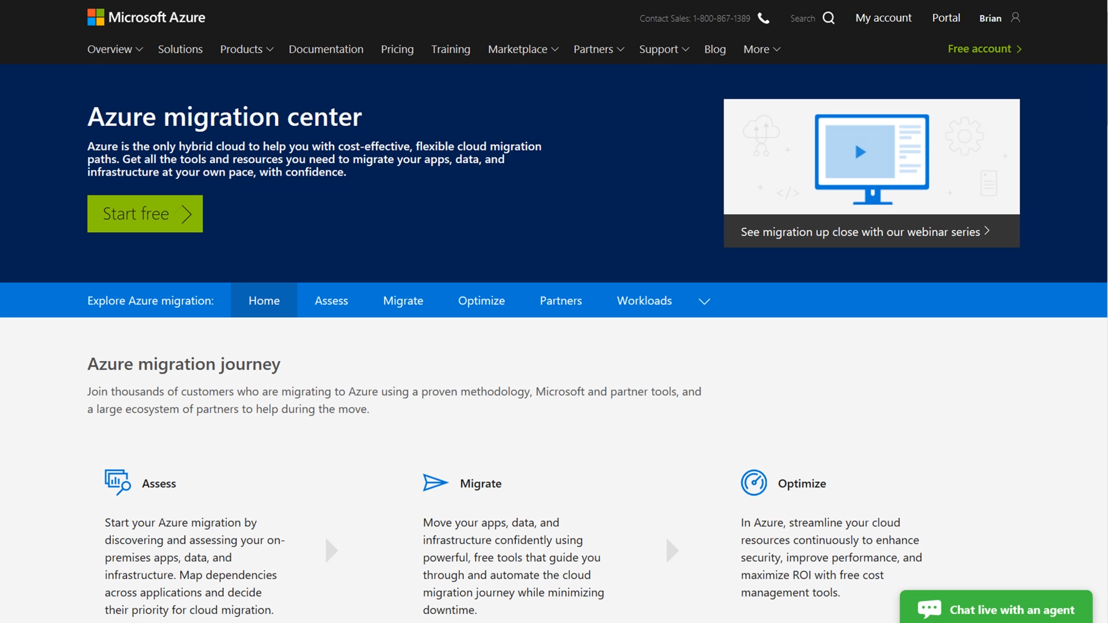
Azure migration center All things migration
Guidance
Tools
Partners
Migration journey and strategies
Right tools for the job
Migration experts
Azure.com/Migration

Slide 19
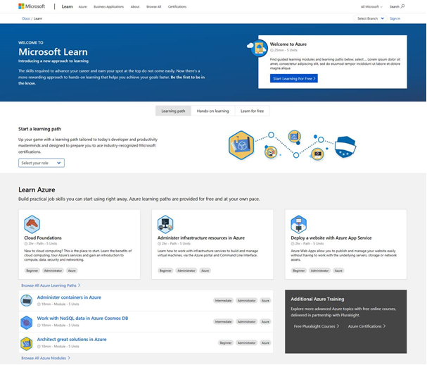
Keep up to date on your Azure skills as you migrate
Announcing free migration course Assessing and Planning Azure Migration
Microsoft.com/Learn
Build skills quickly
Measure Azure skill proficiency
Role based certification & training

Slide 20

https://aka.ms/sarahfeedback
Thank you | Q&A
@TechieLass

